Slide 1
4. Resonances-Figures
Chap. 2 Resonances

Slide 2
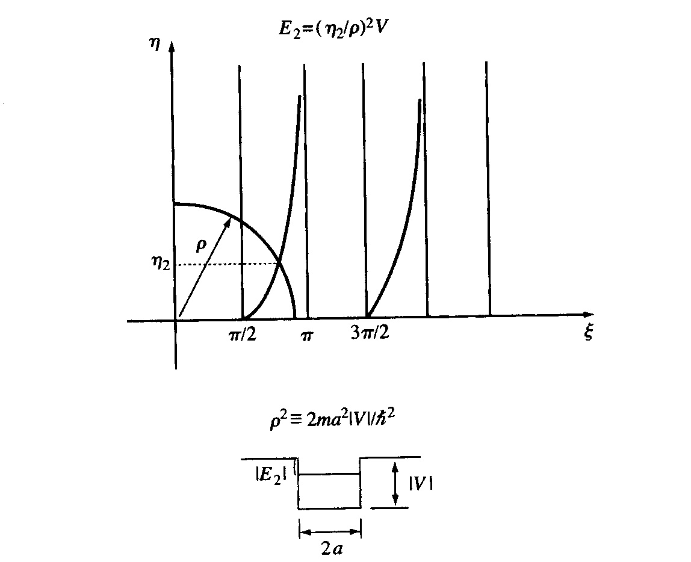
Liboff Figure 8.3
Chap. 2 Resonances

Slide 3
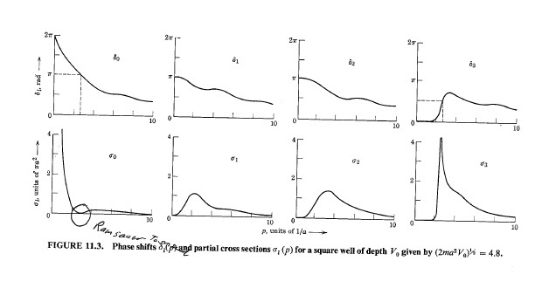
Taylor Fig. 11.3
Chap. 2 Resonances

Slide 4
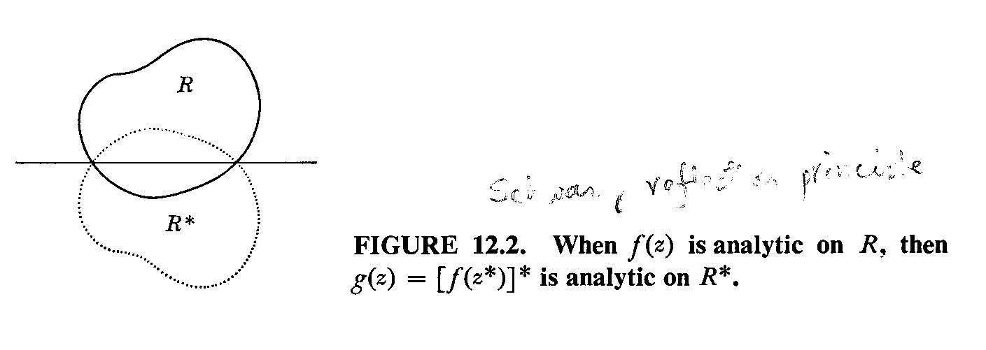
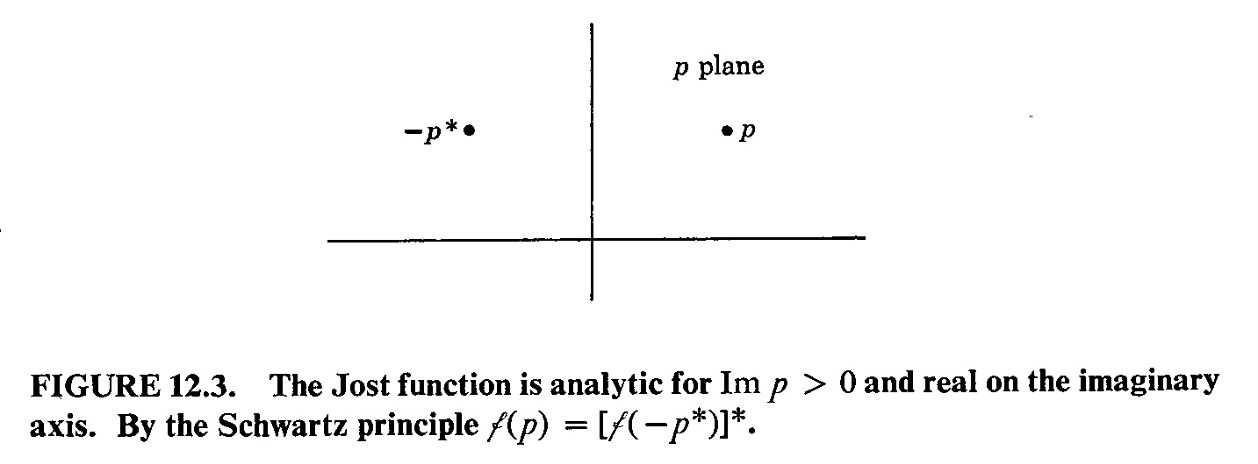
Taylor 12.2 & 12.3
Chap. 2 Resonances

Slide 5
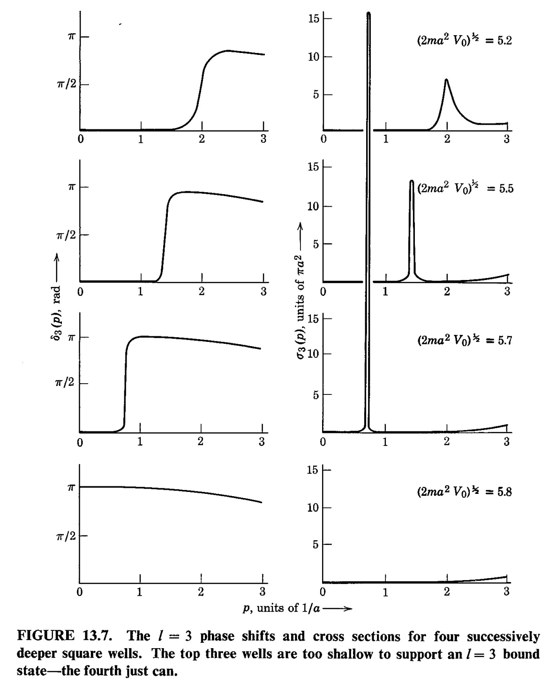
Taylor Fig. 13.7
Chap. 2 Resonances

Slide 6
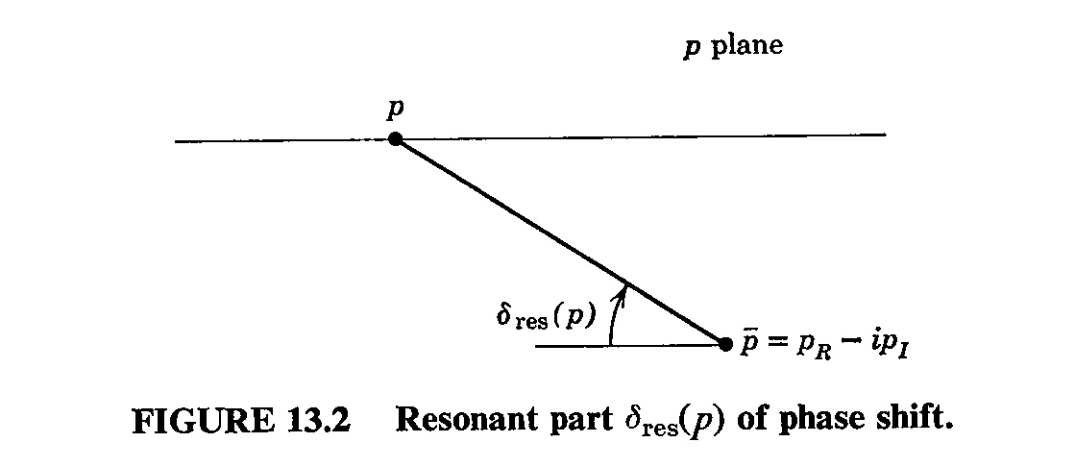
Taylor Fig. 13.2
Chap. 2 Resonances

Slide 7
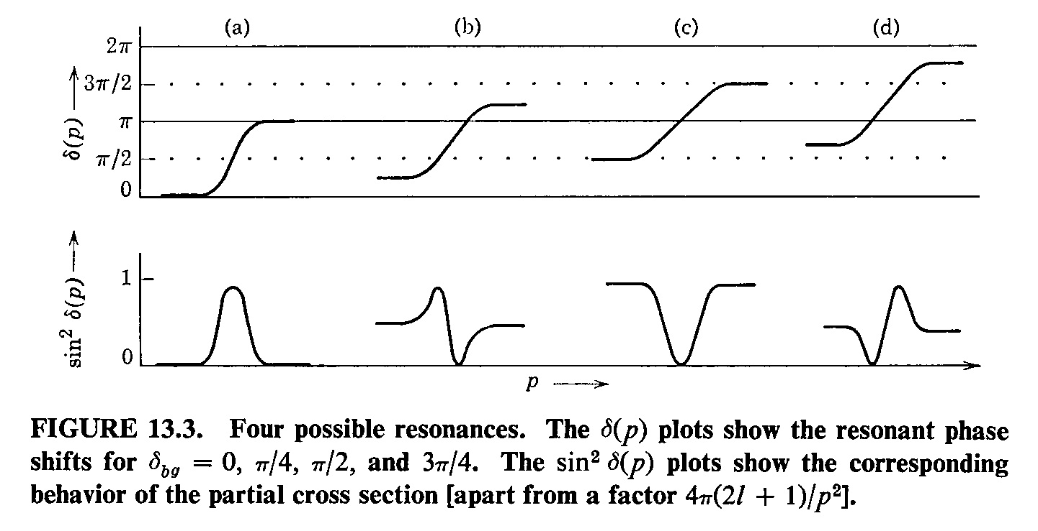
Taylor Fig. 13.3
Chap. 2 Resonances

Slide 8
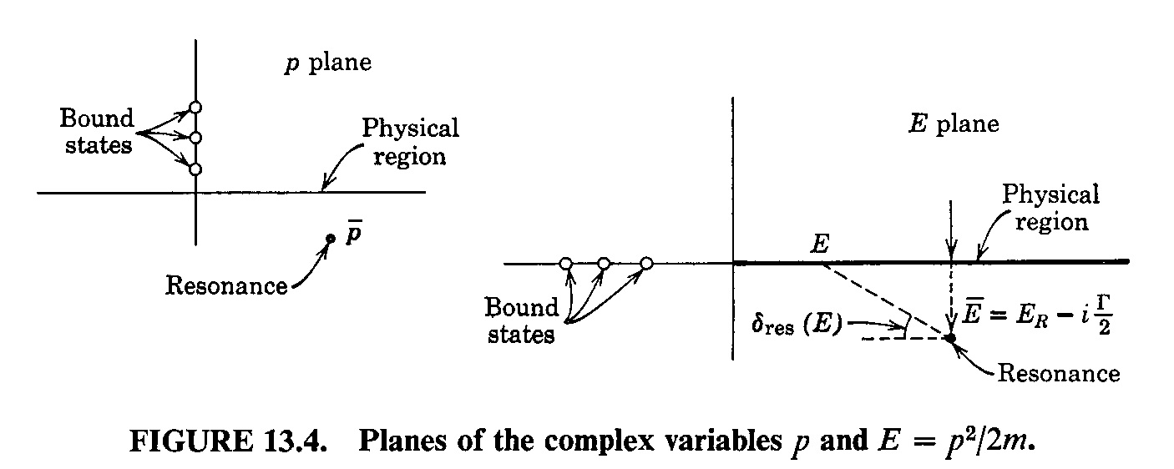
Taylor Fig. 13.4
Chap. 2 Resonances

Slide 9
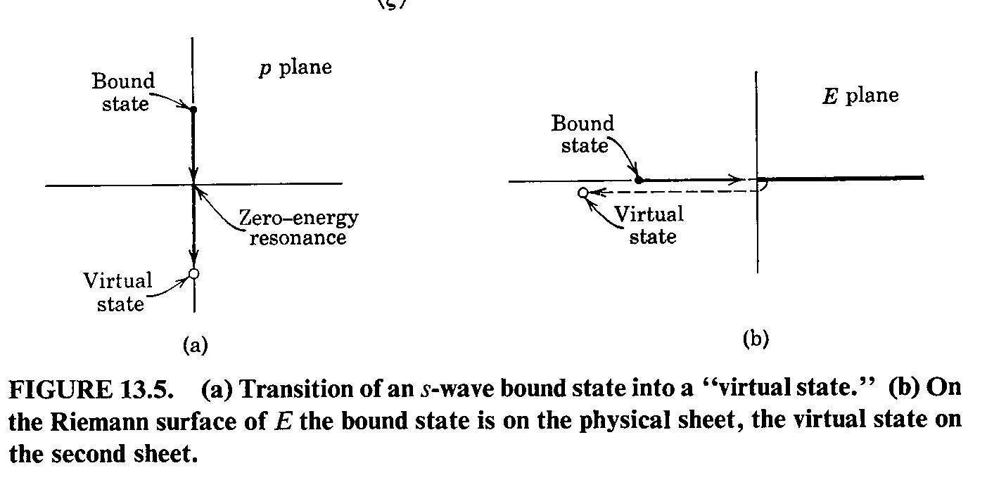
Taylor Fig. 13.5
Chap. 2 Resonances

Slide 10
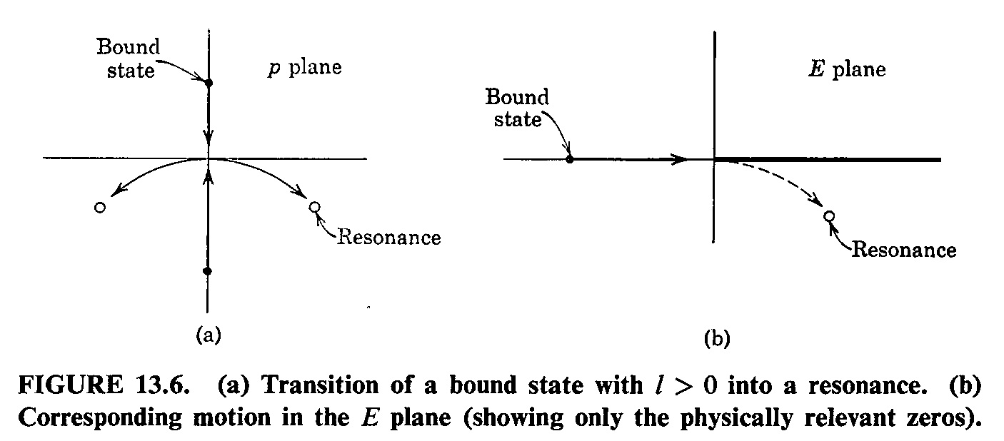
Taylor Fig. 13.6
Chap. 2 Resonances

